Slide 1
INFO 6150 Web Design And User Experience CourseRoom – An Online Learning Portal
Siddhant Kohli (002108396)

Slide 2
Purpose
- CourseRoom is a webspace or portal for educational content and resources that offer a student everything they need in one place.
- It offers the comfort of self-paced learning, Better, time management, Most recent industry-oriented skills.
- The website has a lot of features like searching courses based on the tech field, sending verification emails to avoid fraudulent activities. Student can track their progress by MyCourses.

Slide 3
Features used in CourseRoom
- Used mongoose for connecting MongoDB.
- Used Material-UI for the front-end development.
- Used EmailJS API for the registration process and contact us page.
- Used React and Context for a responsive website.
- Used React hooks for the navigation bar.
- Display Flex wrap is used in the website for the reactive site.
- Postman is used for API testing on a website.
- React DOM for structuring and rendering.

Slide 4
Reference
https://reactjs.org/docs/hooks-custom.html
https://sendgrid.com/wp-content/uploads/2016/09/SendGrid-Implementation-Review.pdf
https://material-ui.com/
https://reactjs.org/docs/hooks-custom.html
https://www.mongodb.com/what-is-mongodb
https://dev.to/daliboru/how-to-send-emails-from-a-form-in-react-emailjs-27d1

Slide 5
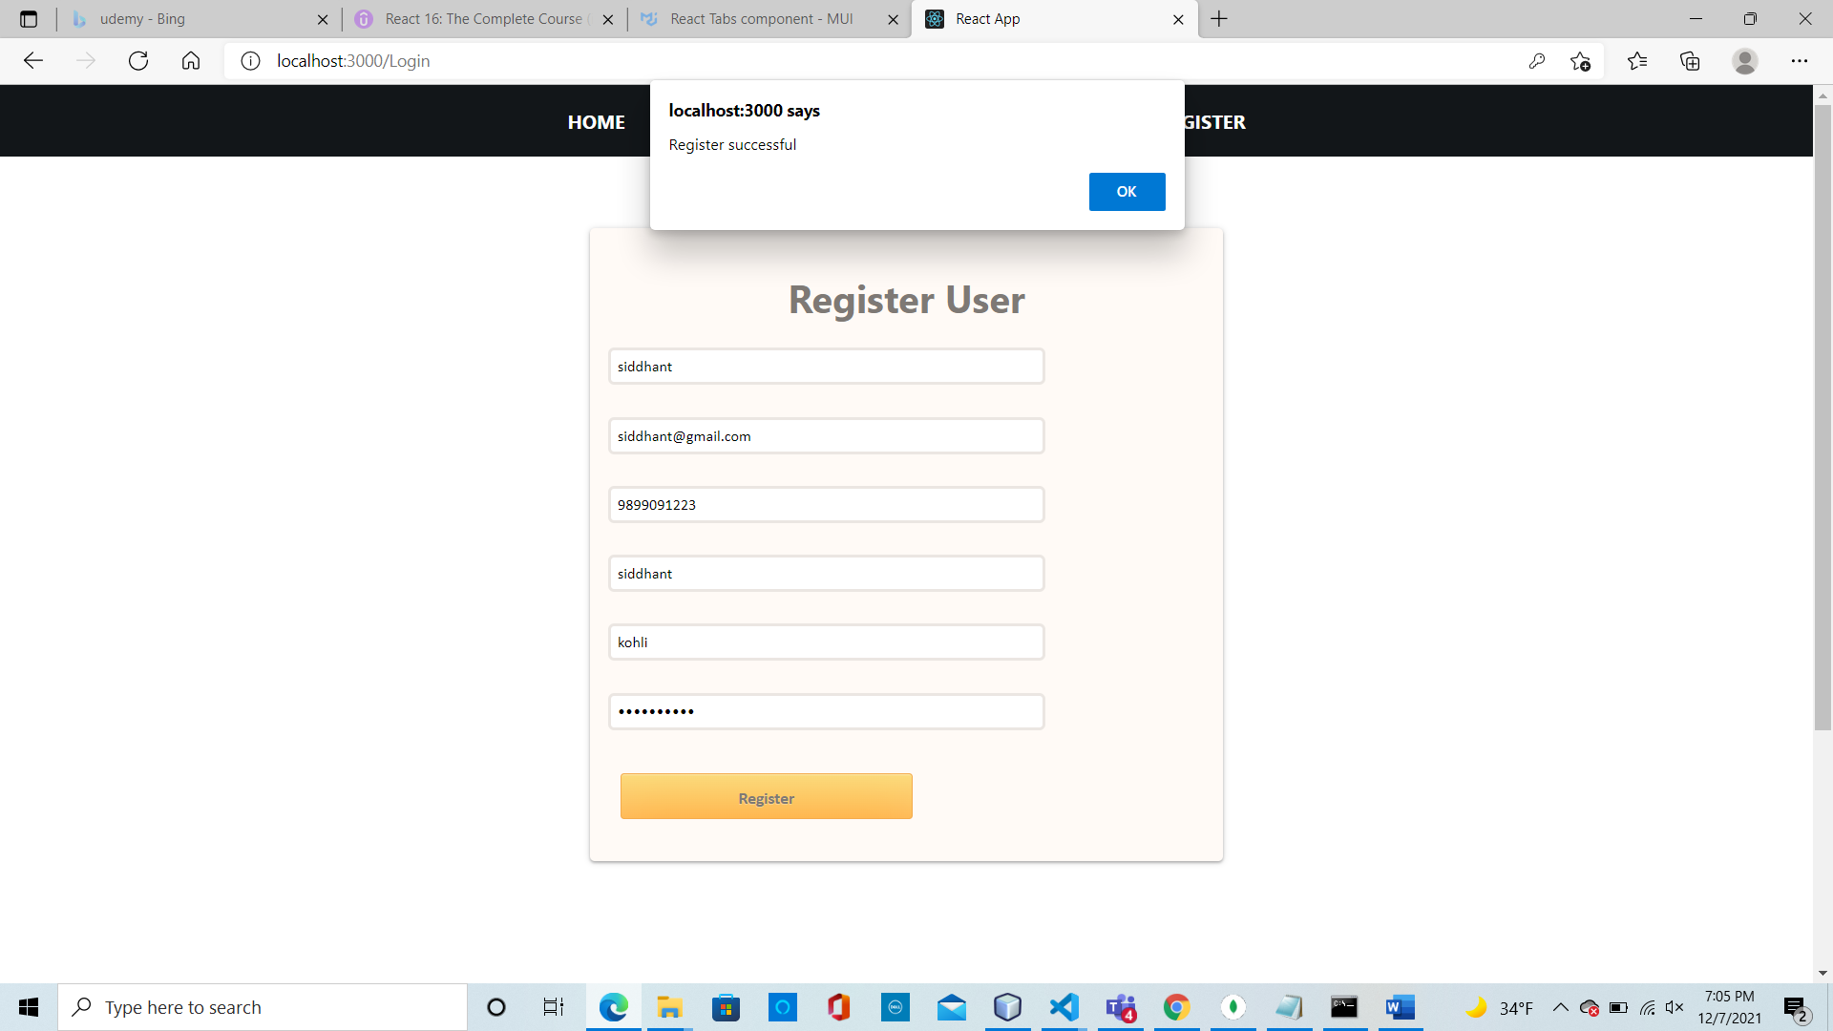

Slide 6
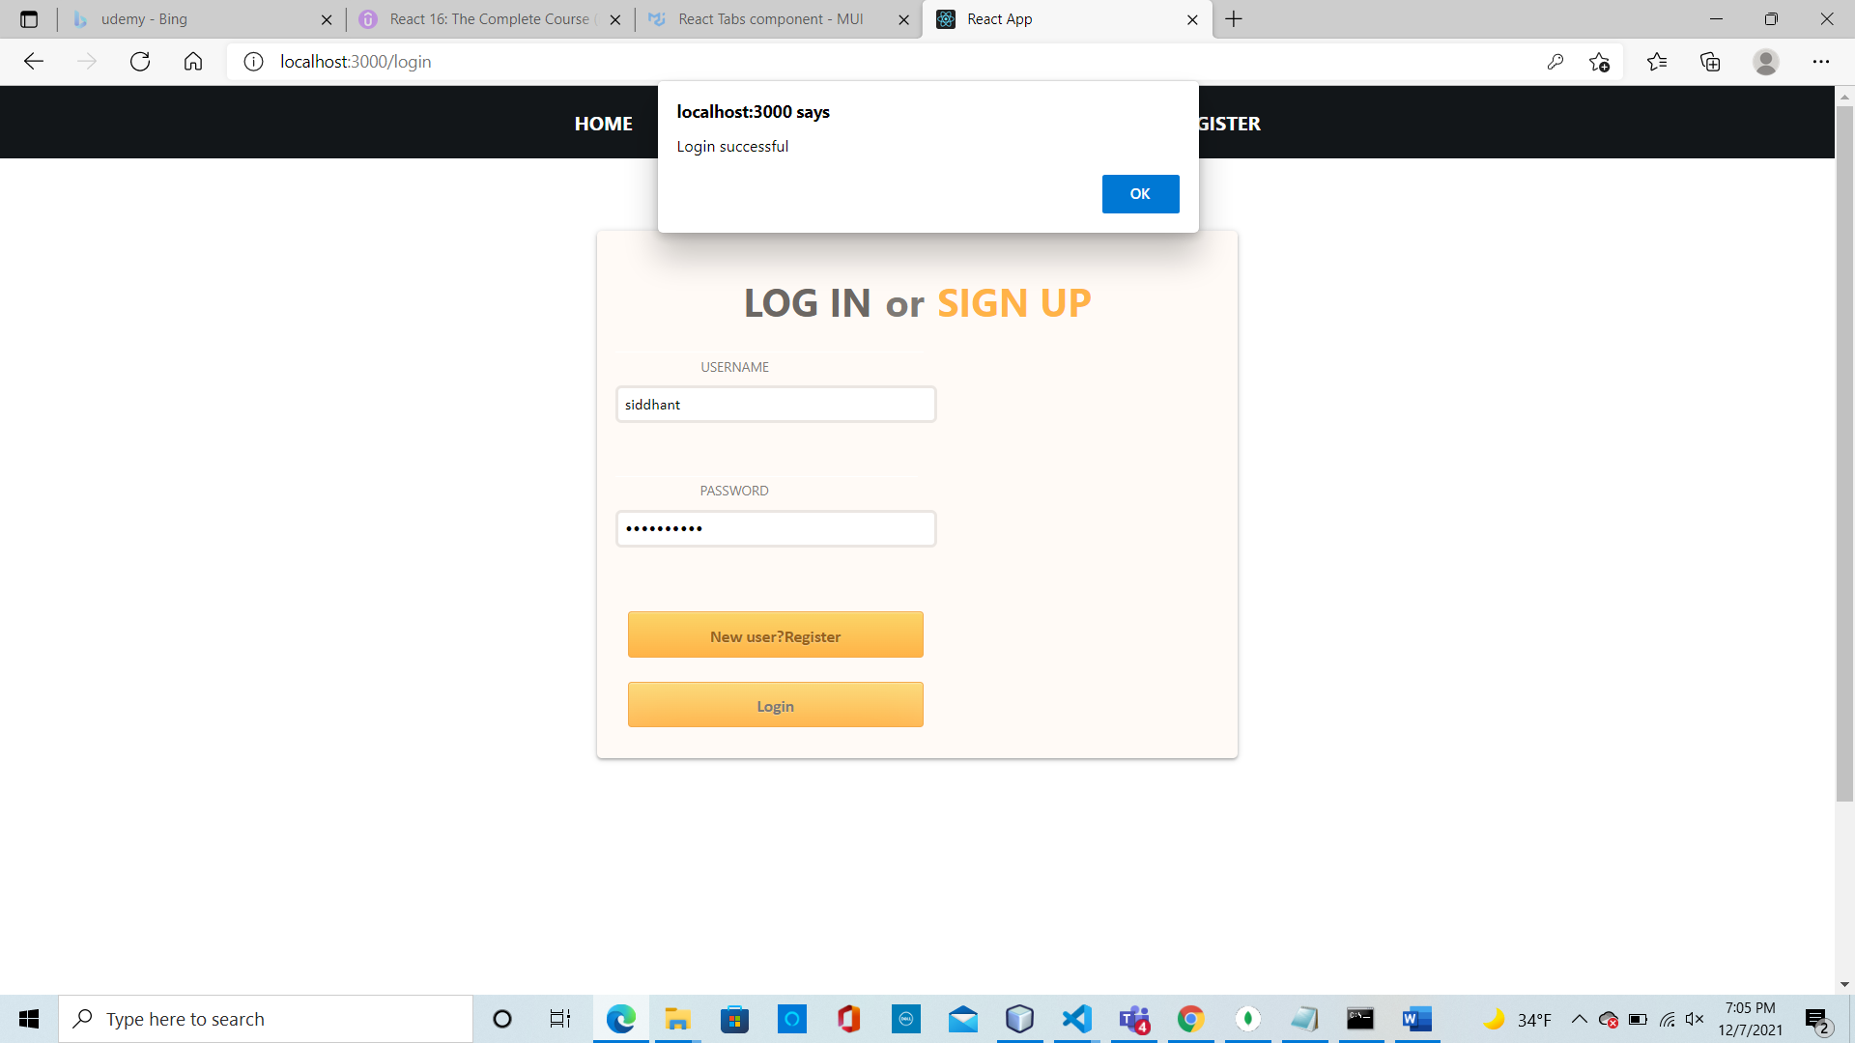

Slide 7
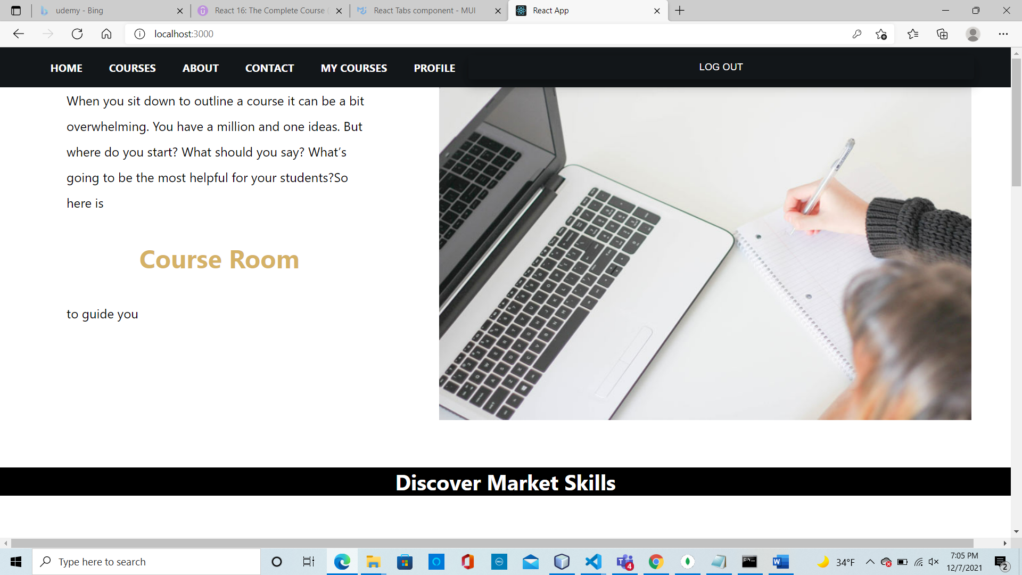

Slide 8
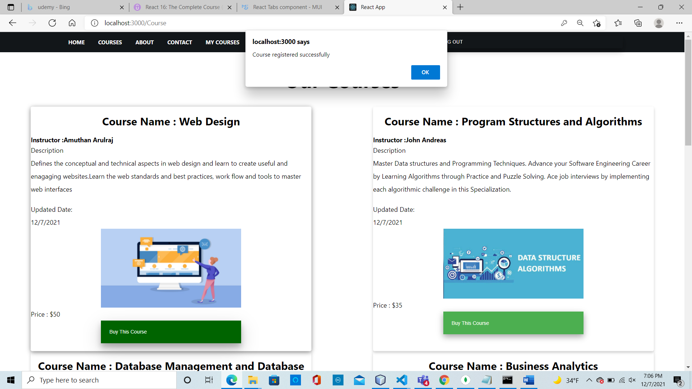

Slide 9
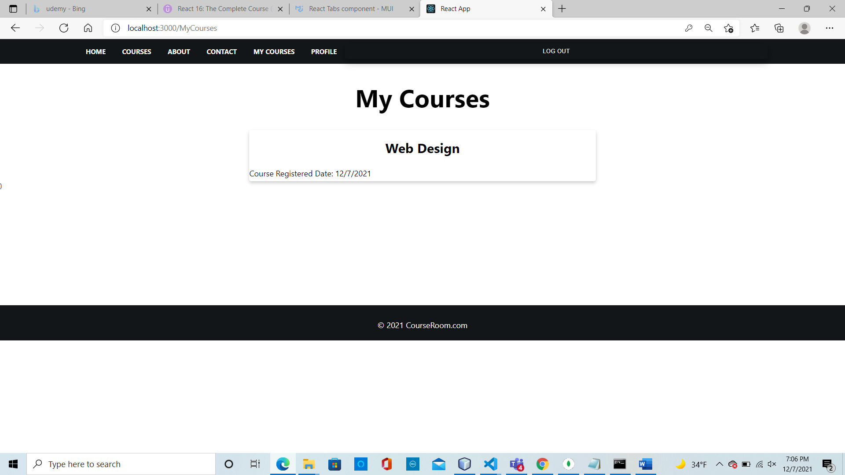

Slide 10
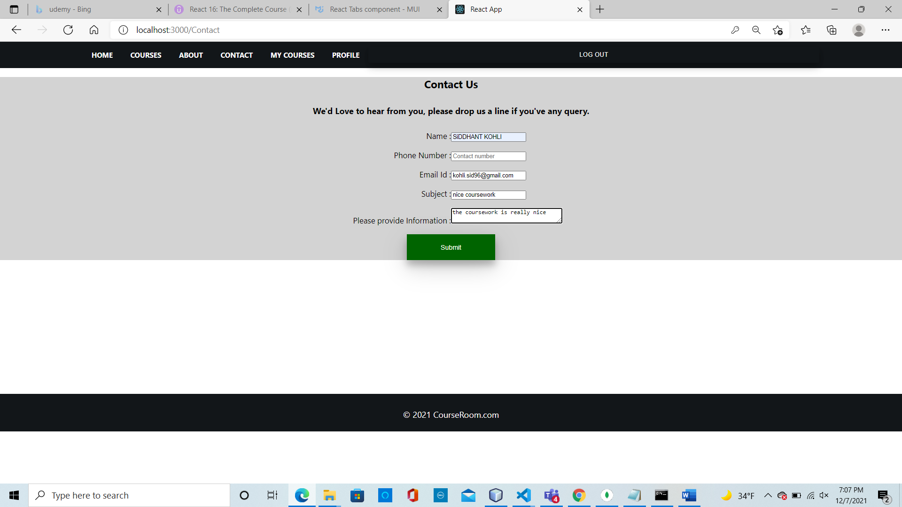

Slide 11
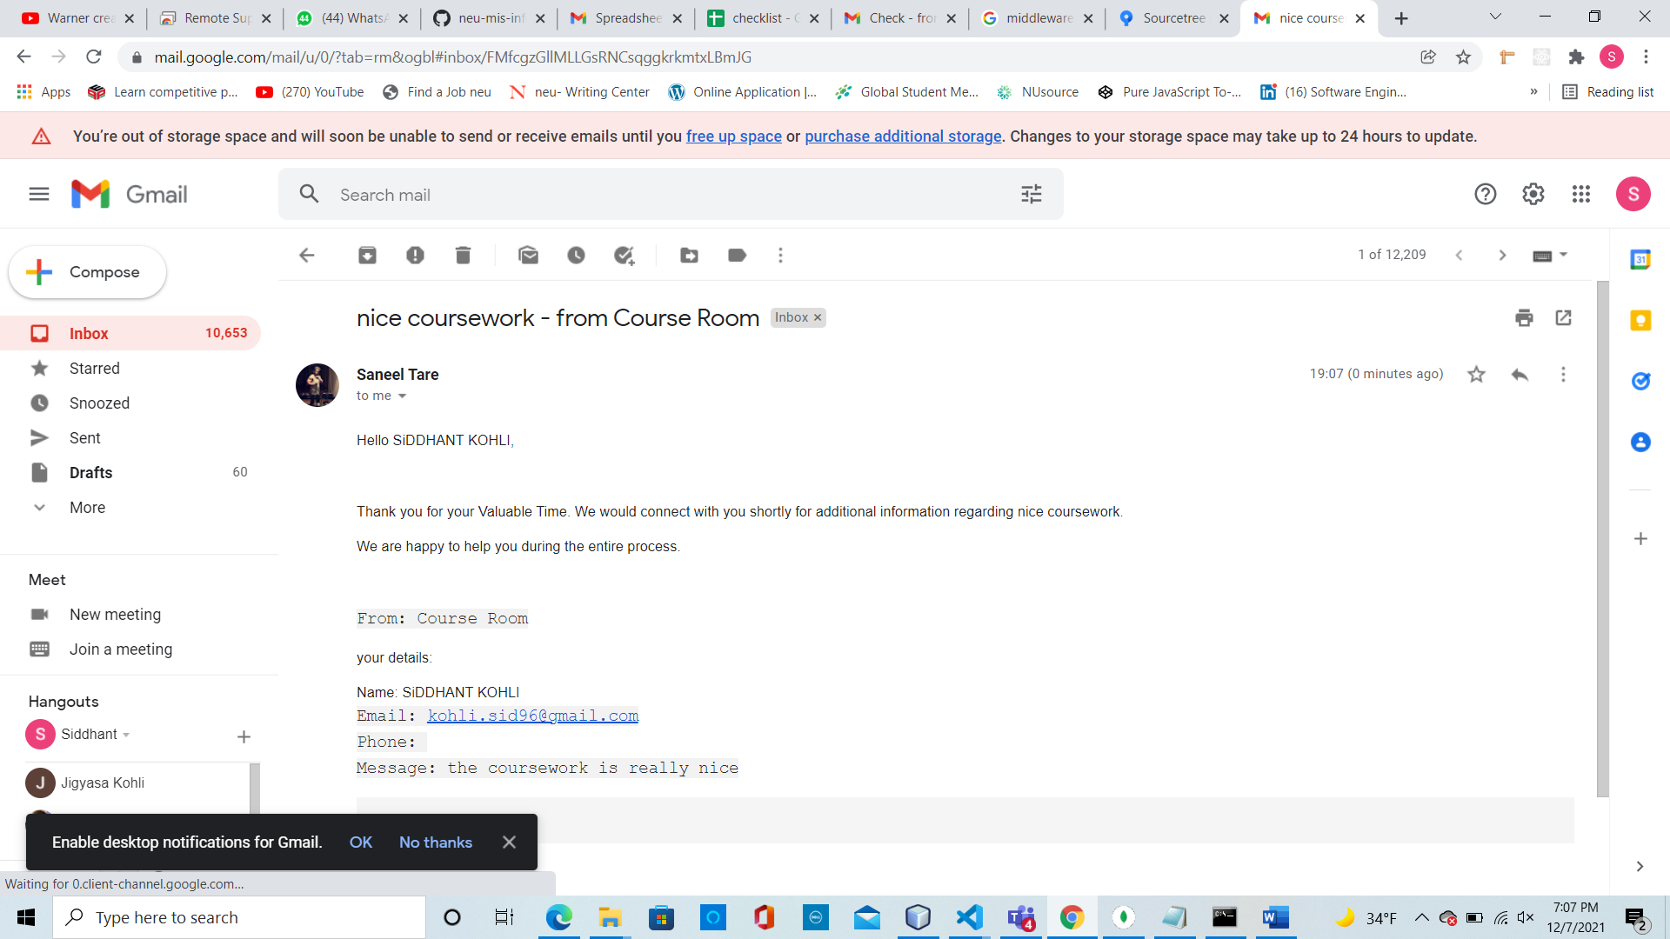

Slide 12
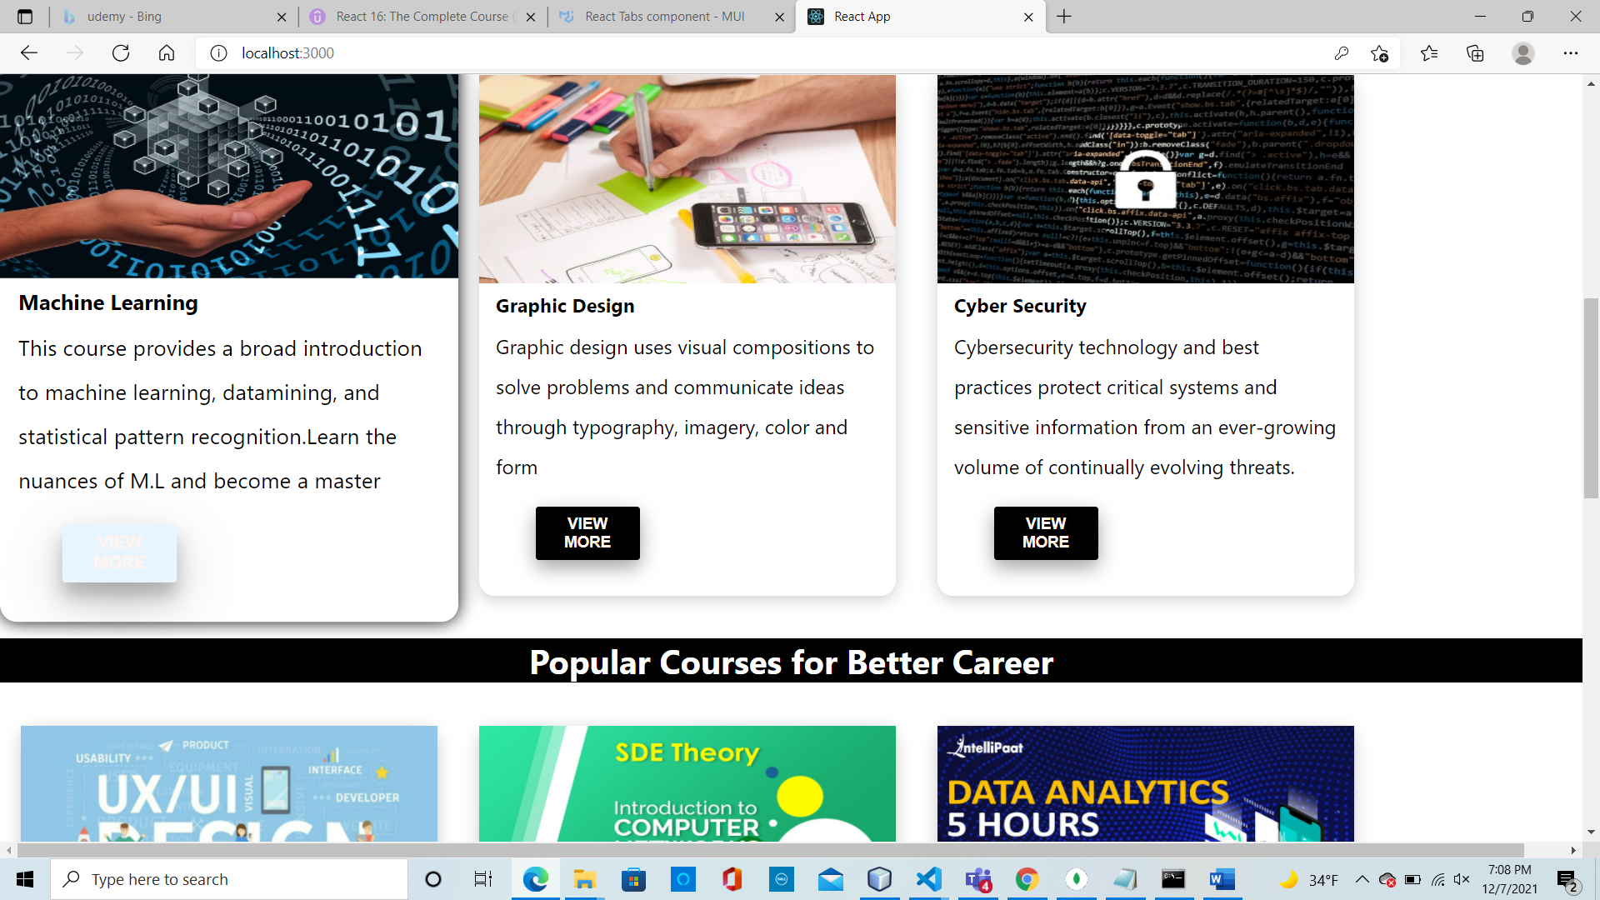

Slide 13
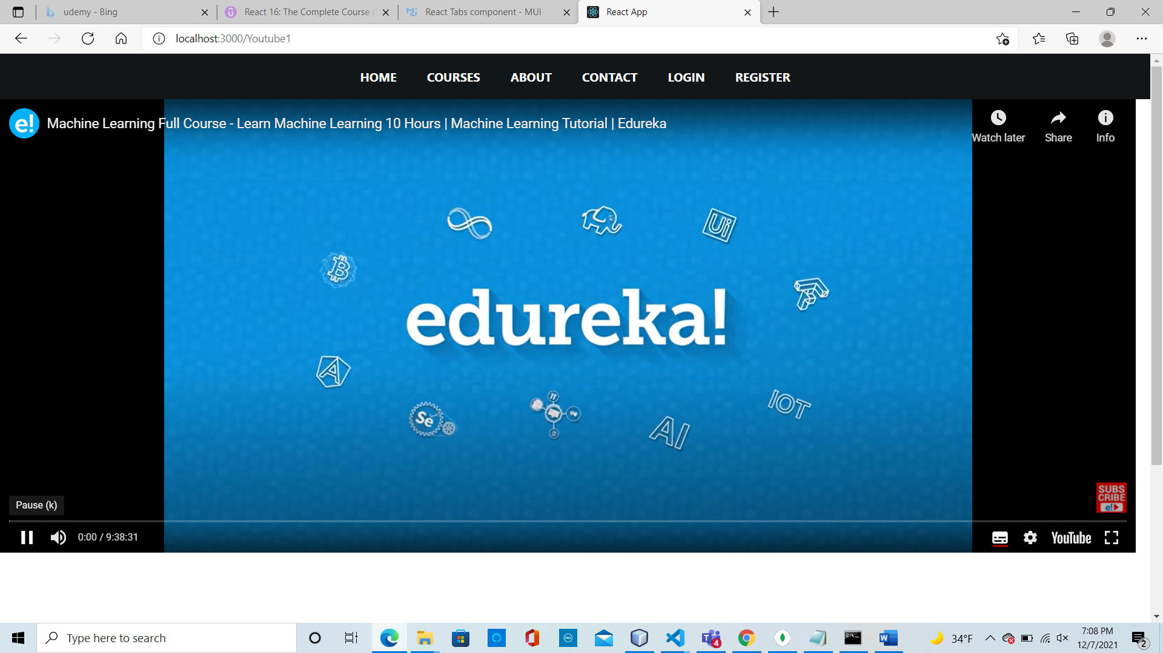

Slide 14
